Slide 1

Looking to 2030: approach and First findings of the OECD STI Forward Look exercise
Presentation to the 1st Asian Innovation Forum
Seoul, Korea, 25-26 August 2015
Michael Keenan
Directorate for Science, Technology and Innovation, OECD

Slide 2
Overview
Some background on the OECD Science, Technology and Industry Outlook (STIO)
How the STIO covers trends and drivers and their projections
Purpose and scope of the ‘forward look’ in the 2016 STIO
The approach so far and the topics being covered

Slide 3
Introducing the OECD’s STI Outlook

Slide 4












OECD STI Outlook: 20-year tradition
Biennial publication
“What’s new in the field of science, technology and innovation policy? “
International review of key recent trends in STI for the STI policy community and analysts
Based on latest STI policy information and indicators
OECD Flagship publication

Slide 5
Drawing on a unique policy questionnaire
Country coverage of the STI Outlook
from 2008 to 2014
Response rate 2014: 96%

Slide 6

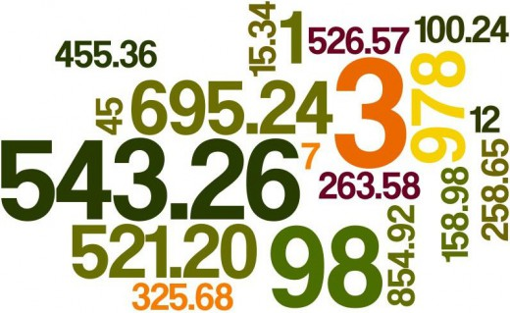

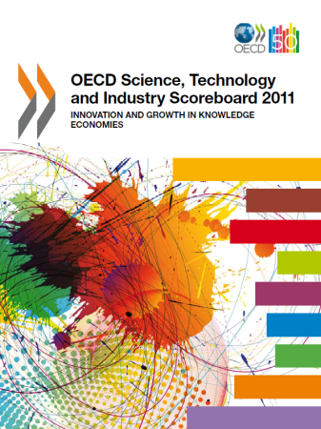
More than a book… An infrastructure for knowledge sharing and building
Analytical work by CSTP WP (e.g. TIP/RIHR)
OECD Committees (e.g. CIIE)
OECD Directorates (EDU, STD, CFE)
Country reviews
Measurement work

Slide 7
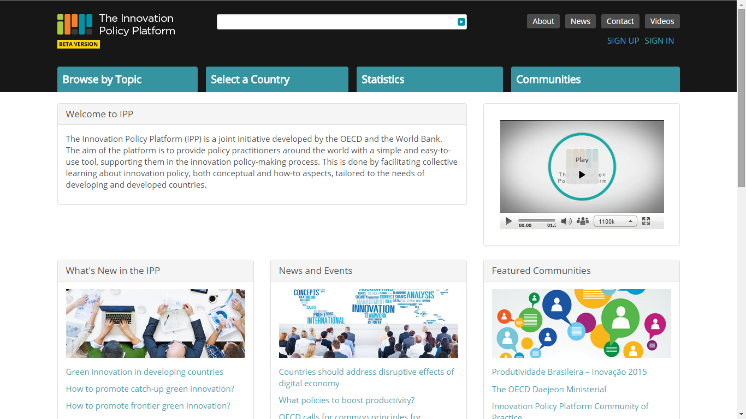
Integration with the OECD-World Bank Innovation Policy Platform

Slide 8
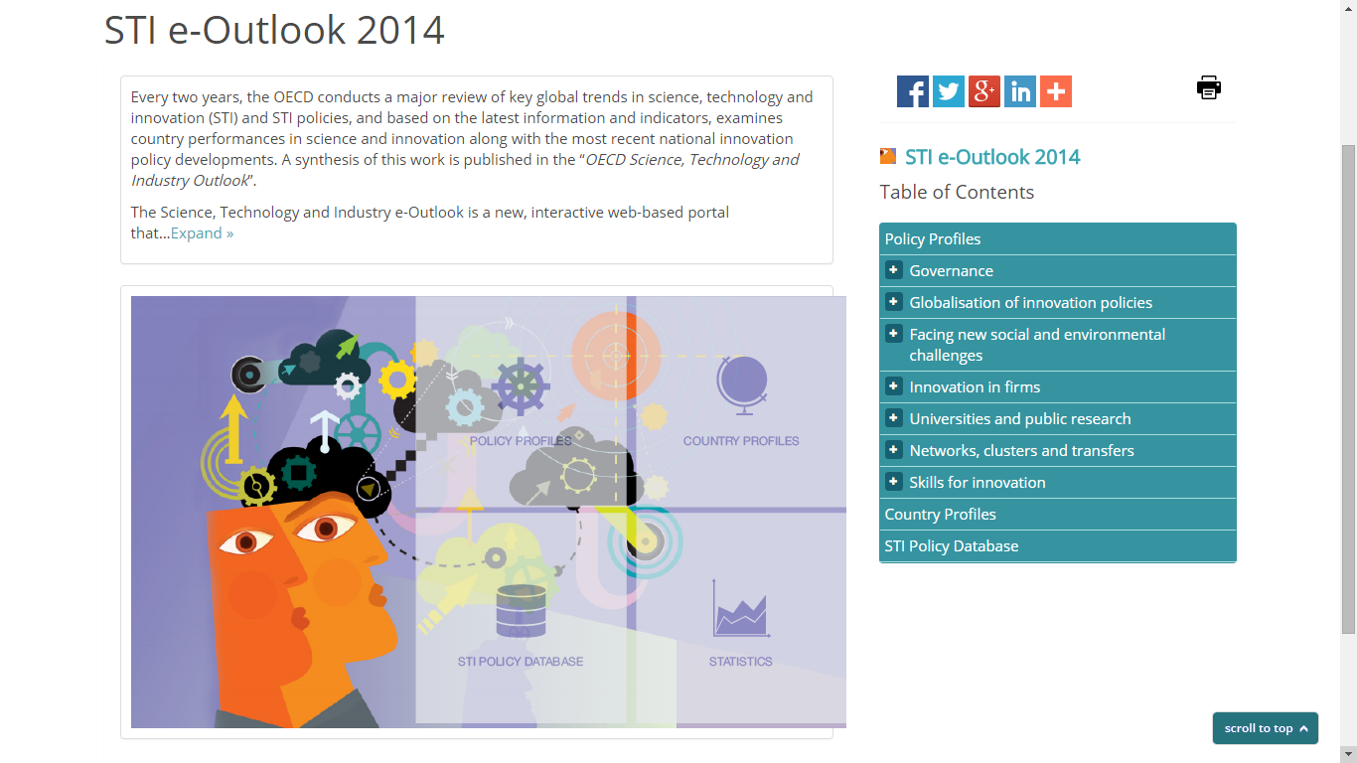
https://www.innovationpolicyplatform.org/sti/e-outlook

Slide 9
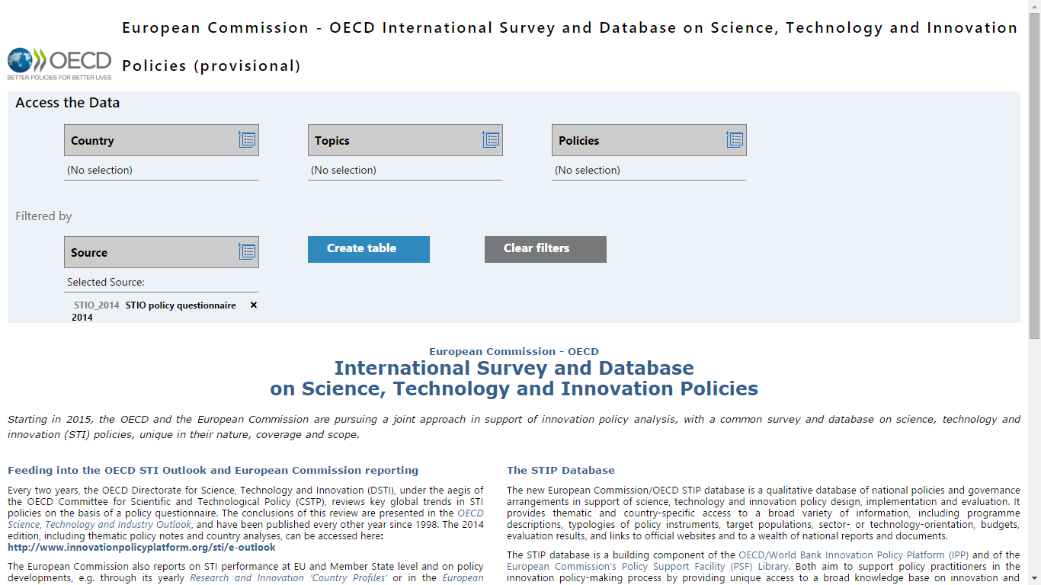
EC-OECD STI Policy Database

Slide 10
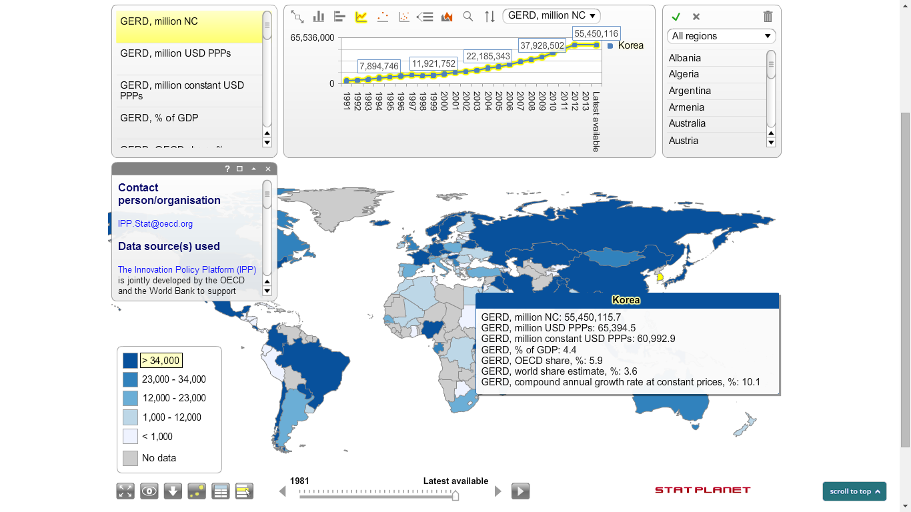
Statistics dashboard

Slide 11
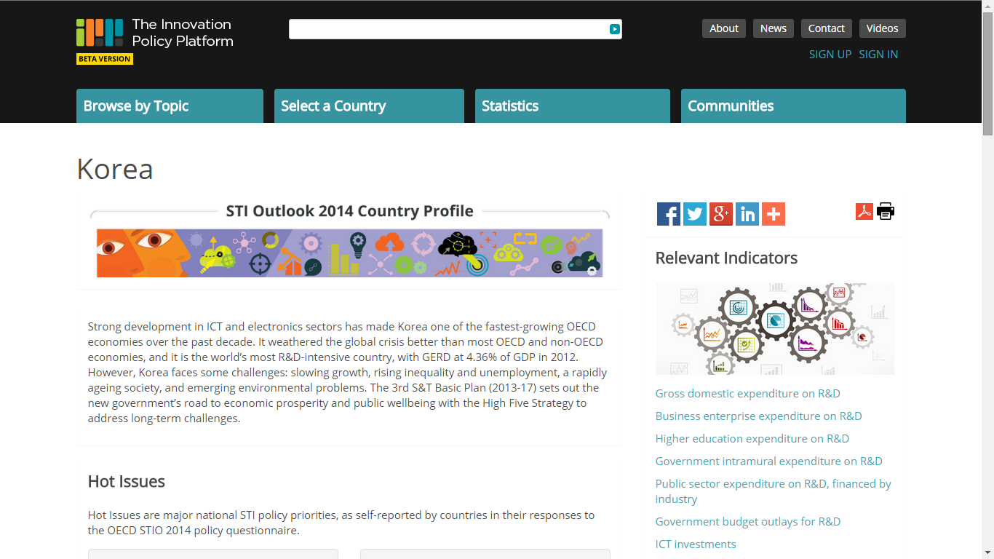
Country profiles

Slide 12

Policy profiles in the 2014 STIO
National strategies for STI
System innovation
Strategic P/PPs
Impact assessment in STI policy
Attracting international S&T investments by firms
Internationalisation of public research
Cross-border STI governance
Green innovation
Innovation for social challenges
Policy mix for business R&D and innovation
Govt financing of business R&D and innovation
Tax incentives for R&D and innovation
Financing innovative entrepreneurship
Start-ups and innovative entrepreneurship
New industrial policies
Stimulating demand for innovation
Public research missions and orientations
Financing public research
Open science
Commercialisation of public research
Innovation and the digital economy
Cluster policy and S3
Patent policies
IP markets
Strengthening education and skills for innovation
Labour market policies for the highly skilled
Building a science and innovation culture

Slide 13
Changes for the 2016 STIO
OECD STIO Survey => EC-OECD Science, Technology and Innovation Policy Survey
OECD STI Policy database => new joint EC-OECD STI Policy information management system integrated into the IPP and the EC’s Research and Innovation Observatory / Policy Support Facility
>470 pages paper publication => <140 pages paper publication, with the country profiles (and probably the policy profiles) published solely on the IPP
Single trends chapter describing current trends and issues => 2-3 trends chapters projecting trends and issues to 2025-2030

Slide 14
The STI Outlook’s existing approach to Exploring Trends and their projections

Slide 15
2014 trends chapter’s overall framing narrative
Maintaining jobs and economic growth in open economies requires greater competitiveness (48 million people unemployed in the OECD)
The transition to a low-carbon economy and the preservation of natural resources is a major challenge
Ageing will dramatically increase pressure on economic performance, social and health care, and public finances
Income inequality has increased during the crisis. ICTs offer opportunities to support inclusive innovation. Education and training policies will be essential to avoid exclusion.
=> Calling for a “new deal” for innovation
Raises the status of innovation in the policy portfolio, while seeking to
Leverage private funding for innovation and
Increase the impact of public action

Slide 16
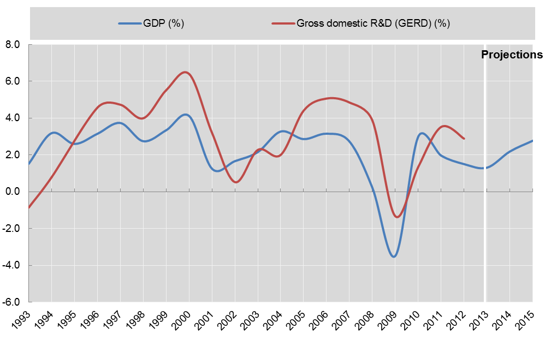
Innovation in the crisis
Annual growth rate of GDP and GERD, OECD, 1993-2013 and projections to 2014 and 2015
Source: OECD Economic Outlook nº95 Database, May 2014; OECD Main Science and Technology Indicators (MSTI) database, June 2014.

Slide 17
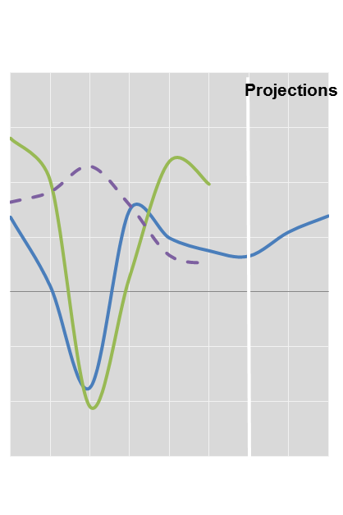
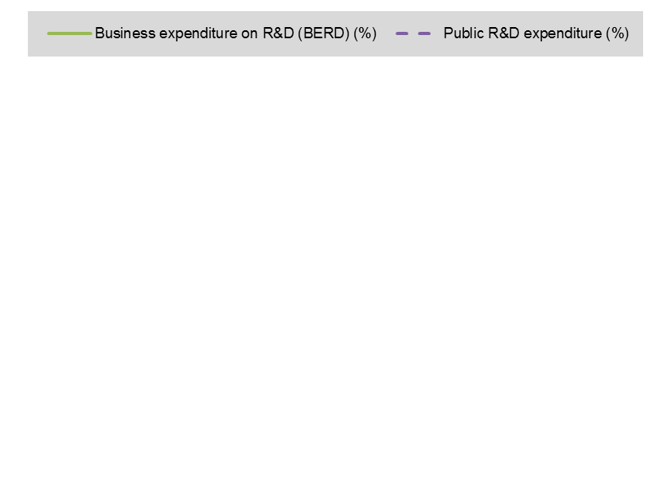
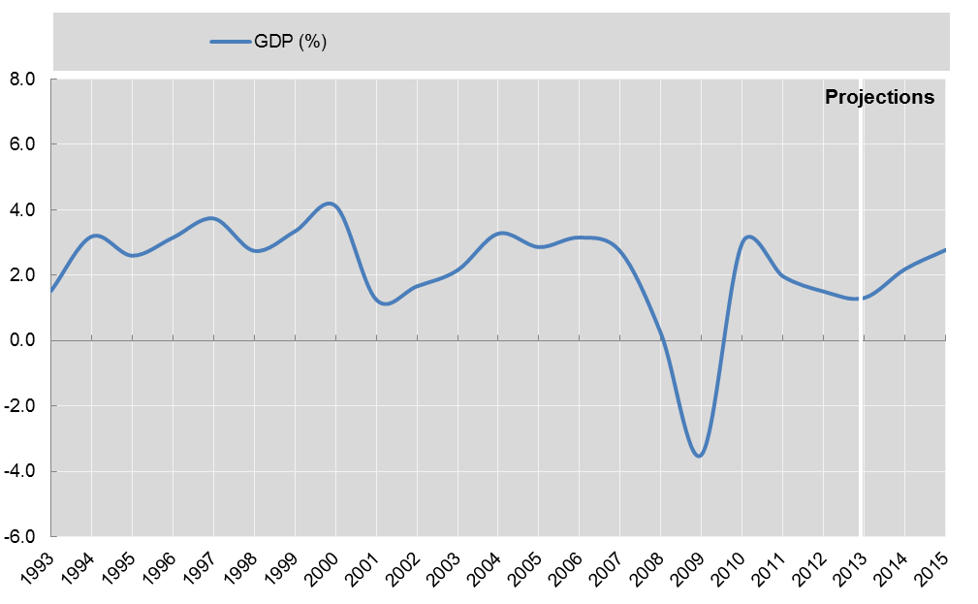
Innovation in the crisis
Annual growth rate of GDP and GERD, constant prices, 1993-2013 and projections to 2014 and 2015
Source: OECD Economic Outlook nº95 Database, May 2014; OECD Main Science and Technology Indicators MSTI database, June 2014.

Slide 18
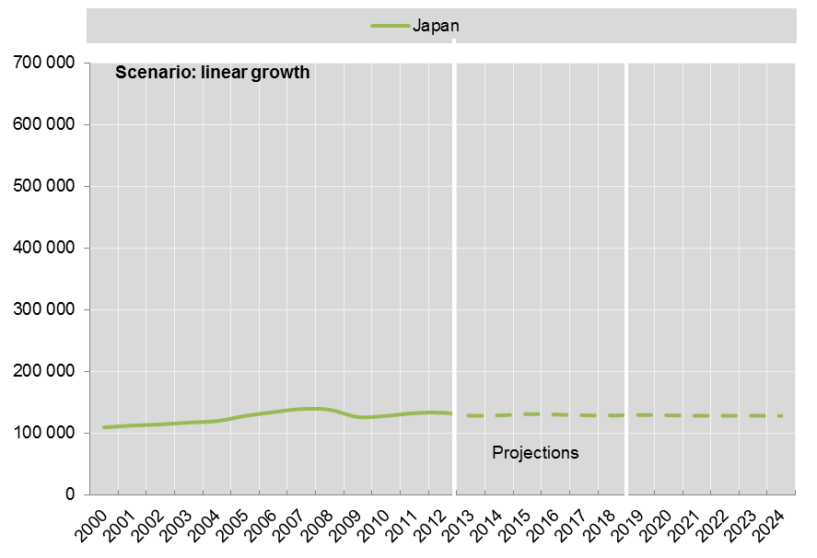
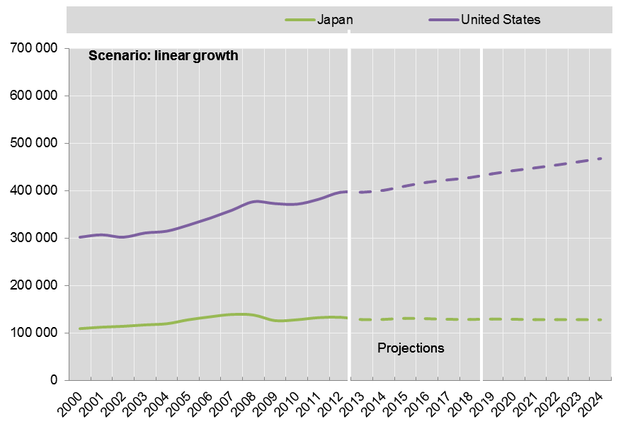
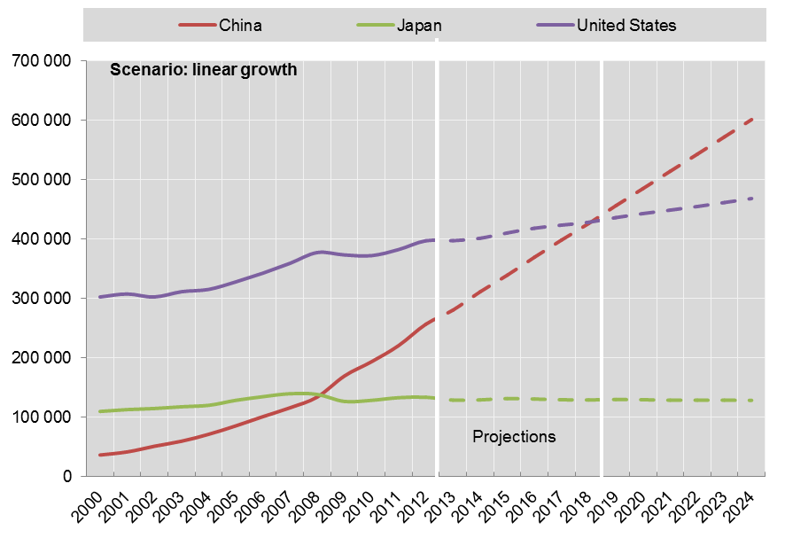
A changing global R&D landscape
GERD, million USD 2005 PPP, 2000-12 and projections to 2024
Source: OECD estimates based on OECD MSTI database, June 2014.

Slide 19
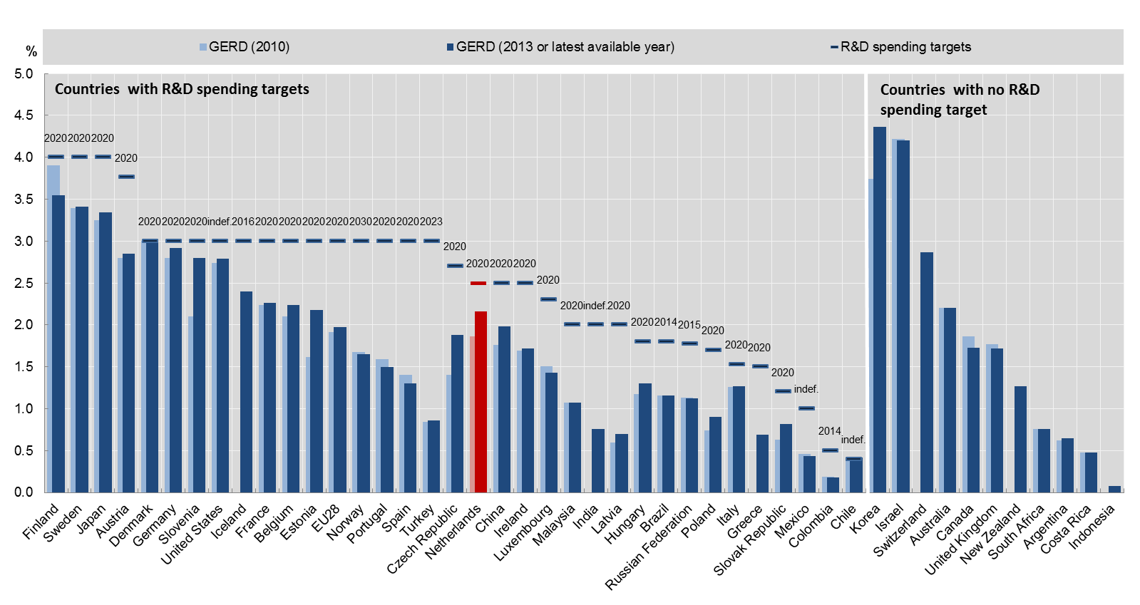
GERD intensity targets shortfalls
National R&D spending targets and gap with current levels of GERD intensity, % of GDP, 2014
Netherlands
Source: OECD estimates based on OECD MSTI database, June 2014.

Slide 20
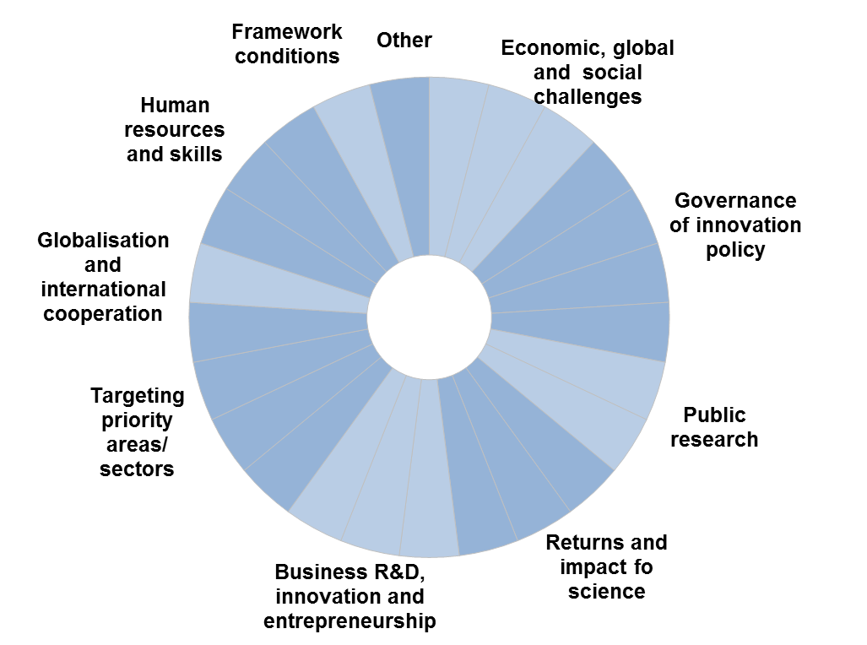
Hot issues – self-reported by countries

Slide 21
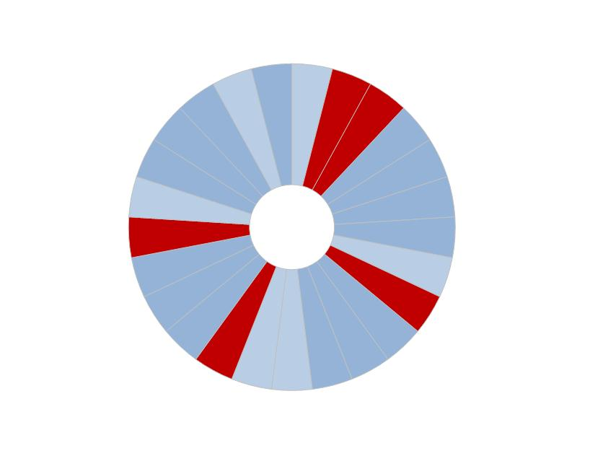
Korea hot issues
Structural adjustment and new approach to growth
Sustainable and green growth
Targeting priority areas/ sectors
Public R&D capacity and infrastructures
Business innovation, entrepreneurship and SMEs

Slide 22
Japan hot issues

Slide 23
China hot issues

Slide 24
Malaysia hot issues

Slide 25
India hot issues

Slide 26
Indonesia hot issues

Slide 27
Frequency of occurrence of hot issues across the six Asian countries surveyed
* Number of countries responses

Slide 28
a ‘forward look’ exercise to stretch the Outlook’s time horizons

Slide 29
Forward Look: why, what and how
Criticism of past STIOs: an outlook should look further out than the present and near-future . . .
Stretch time horizons 10-15 years by way of a study that can feed into the trends chapter(s) of the 2016 STIO
However, relatively few resources and little time available:
7 months (fte) OECD Secretariat + 3 junior external consultants with foresight experience, 7 months (fte)
Project got underway in June 2015 and needs to be more or less completed by the end of 2015
Goals:
Using existing sources, describe current trends and drivers and their interactions
Project these trends and drivers 10-15 years into the future, exploring possible interactions and discontinuities
Approach:
Essentially a desk-based exercise complemented by interviews, mini-workshops, and country responses to the joint EC-OECD STIP survey
Intentionally described as a ‘forward look’ rather than a ‘foresight’ exercise
Seek synergies with what countries are doing and with other ongoing OECD projects
A largely qualitative approach with no sophisticated quantitative forecasting

Slide 30
Five elements
People, communities and society
Megatrends – provide a preamble, largely indicator-based and visually-appealing
Technology trends - 10(?) major technology developments and their possible impacts
STI trends - changing shape and culture of the public science system and innovation systems
Policy trends - shifts in (STI) policy agenda-setting, design and implementation

Slide 31
Steps for ordering, synthesising and making sense of what we find
Megatrends and some of their implications for STI are set out in a first section
Technology trends are set out separately and their possible implications for STI policy highlighted
Current trends and drivers in STI and STI policy are set out. The 2014 trends chapter does this reasonably well already, so this is our starting point
These trends and drivers are projected 10-15 years into the future. At the same time, the implications of the megatrends and technology trends are considered
Narratives will be built around tensions / controversies that arise. Some of these are ‘perennial’ tensions / controversies; others will likely be more novel

Slide 32
Megatrends: initial candidates (1)
Demographics including global redistribution, gender and ageing
Urbanisation (incl. internal mobility)
International migration
Societal changes (culture, family structure, generations X-Y-Z, societal expectations, entertainment, communications, gaming)
Richer but more unequal, rise (and fall) of the middle class
Democratisation of knowledge: higher education, science, innovation, access to ICT/Internet/Information
Health trends: obesity, cardio vascular diseases and non-contagious diseases, mental health (Alzheimer), pandemics, antibiotic resistance
Global shifts in power: different rates of economic growth, trade, soft power, military power, access to resources (incl. water, energy), money (changes in commodity prices)

Slide 33
Megatrends: initial candidates (2)
Natural resources competition and depletion (water, soils, oceans, biodiversity, agriculture)
Climate change: Co2 emissions, natural catastrophes
Energy trends: global demand, energy mix, new sources of energy
Globalisation: trade, FDI, finance, R&D, grand challenges
Changes in economic structure, productivity and jobs: technology, services, intangible assets, service content of manufacturing
Financialisation of everything
Shifting roles of the State: public spending, tax revenues, pensions and healthcare systems, regions, shift in decision making
Technological change: impacts of technology, mutual shaping of technology and society, technological convergence

Slide 34
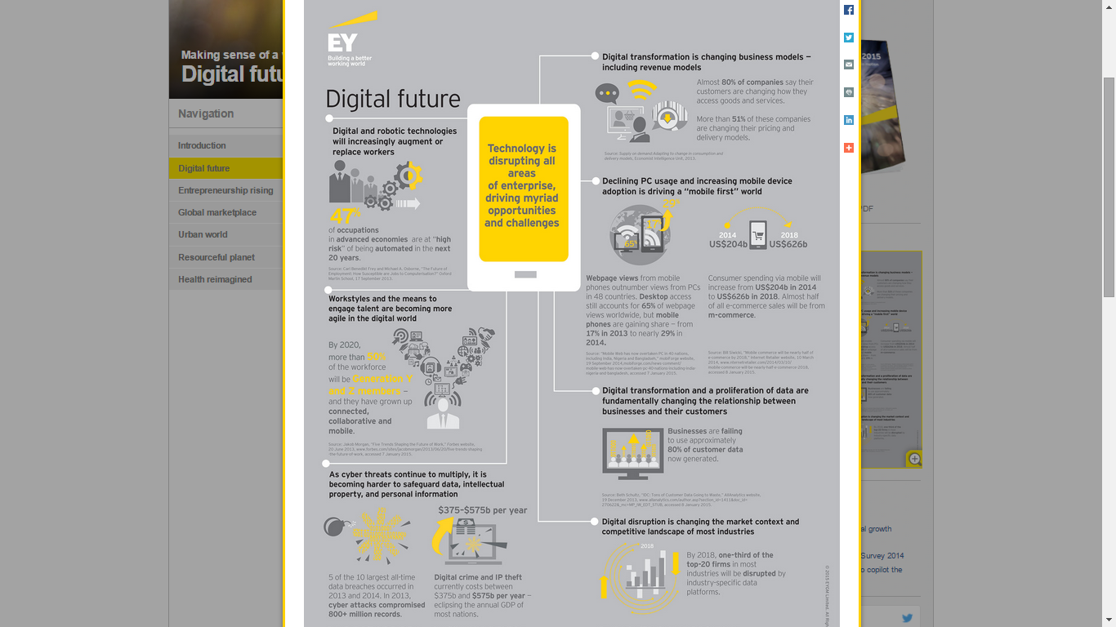
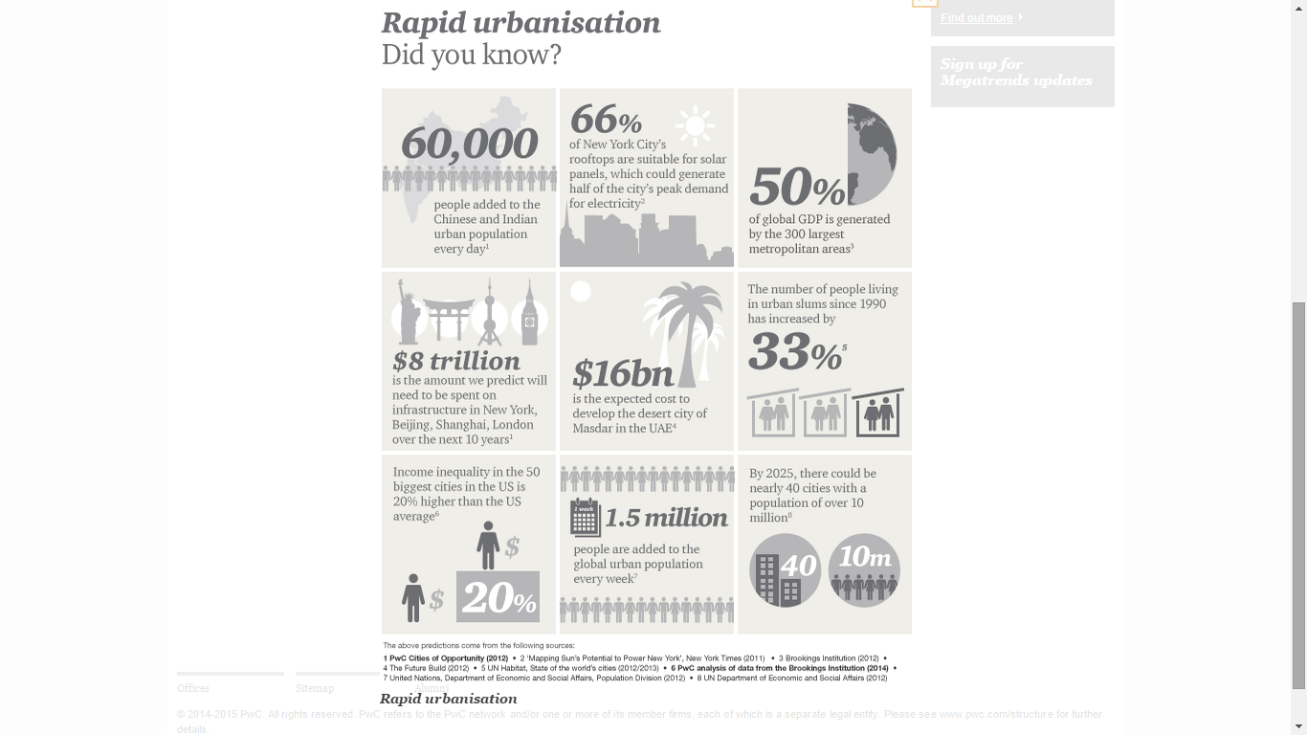
Presentation of megatrends

Slide 35
Possible technology areas
Looking to identify 10-12 technology areas:
What areas are the most promising over the next 10-15 years?
What areas are potentially ‘disruptive’?
What areas carry significant risks?
Our choice largely depends on what countries are finding in their foresight exercises; but we’ll also seek to use other sources of techno-scientific promises
Appropriate level of aggregation?

Slide 36
Sample of STI dynamics trends: public research
Greater proportion of public R&D performed in universities
Public research funding framing: shift towards user perspectives, grand challenges, multi-disciplinarity, excellence (narrowly-defined)
Public research funding modes: more programme funding, rebalancing between core and competitive project-based funding, rise of importance of non-govt funding of public research
Rise of managerialism at all levels – NPM in policy, managerialism in universities, autonomy with accountability
Open science and open innovation
Growing focus on ‘third missions’, incl. commercialisation
Growing internationalisation: funding, mobility, cooperation
Growing pressures on research careers: contracts, market capacity, PhD skills, reward mechanisms, gender imbalances
Growing concerns around research integrity, peer review mechanisms

Slide 37
Policy trends and issues
Broader policy mission for STI policy: more goals, targets, actors
Fragmentation: agencification, specialisation, hollowing-out?
Multi-level governance: sub- and supra-national levels
Growing array of policy instruments, e.g. demand side, R&D tax incentives
Greater use of evaluation, but persisting gaps in metrics
More attention to managing socio-technical risk and uncertainty
Fiscal consolidation / tight budgetary constraints
Shifting perceptions of policy processes and roles of governments?
Complexity thinking, wicked problems, experimentation, etc.?
Public sector innovation?

Slide 38
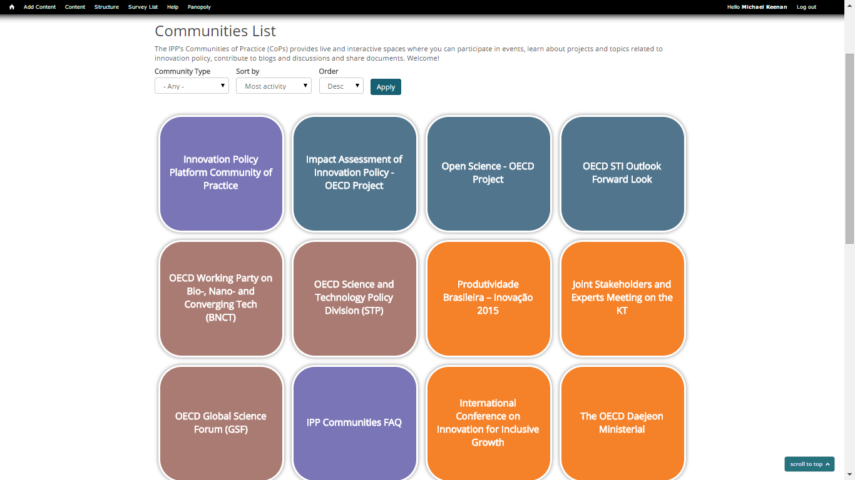
Dedicated community space on the IPP

Slide 39
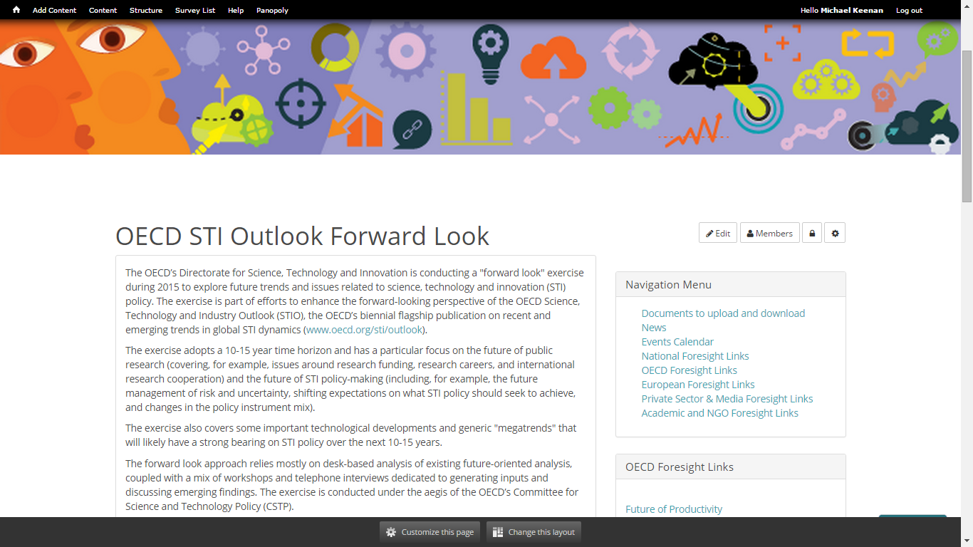
https://www.innovationpolicyplatform.org/oecd-sti-outlook-forward-look
*Publicly available in September 2015

Slide 40
Thank you!
michael.keenan@oecd.org

